Slide 1
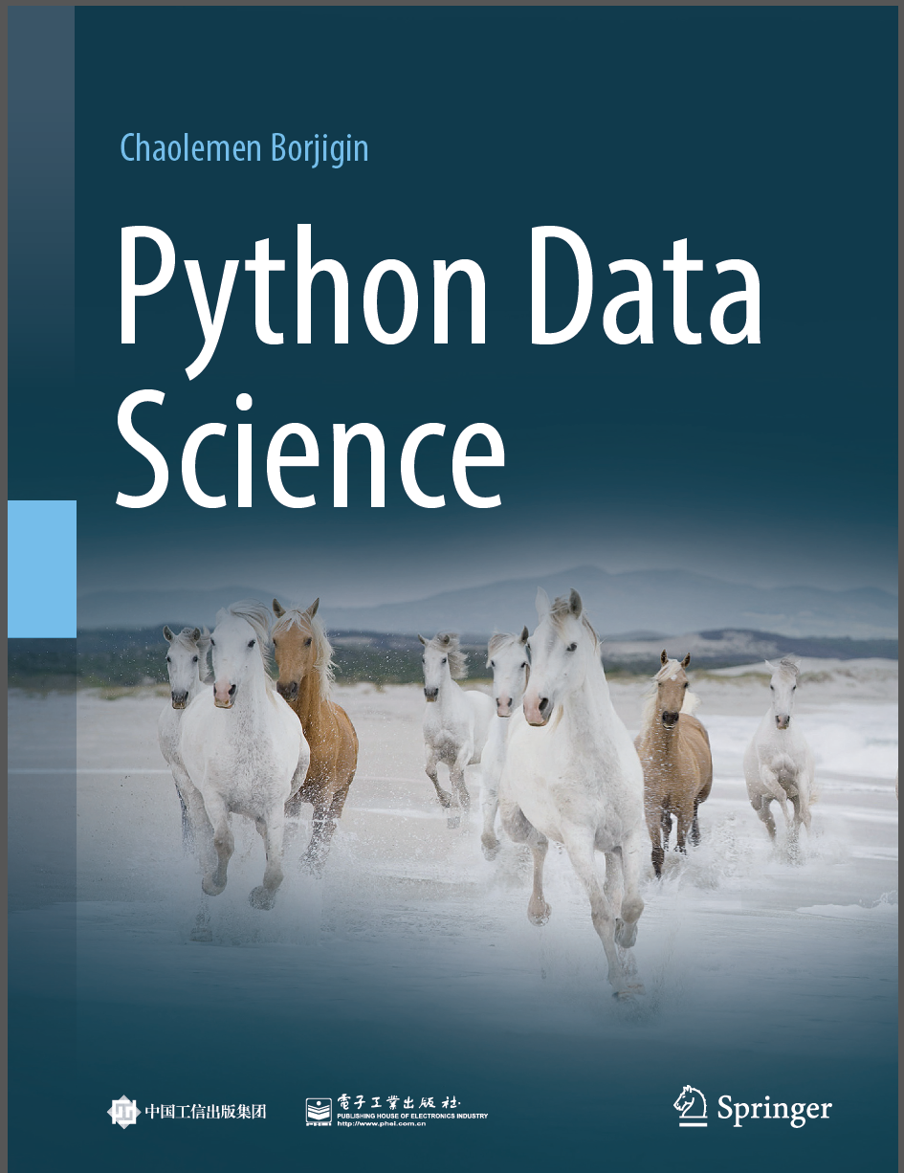
Python Data Science
Chaolemen Borjigin
Renmin University of China
chaolemen@ruc.edu.cn

Slide 2
2.16 Functions
▼ Chapter 2 Basic Python Programming for Data Science
► 2.16 Functions
Chaolemen Borjigin
Renmin University of China
chaolemen@ruc.edu.cn

Slide 3
Summary of this chapter
▼ Chapter 2 Basic Python Programming for Data Science
► 2.16 Functions
2.16.1 Built-in functions
2.16.2 Module Functions
2.16.3 User-defined functions

Slide 4
2.16.1 Built-in functions
▼Chapter 2 Basic Python Programming for Data Science
► 2.16 Functions
In[2]:
i=20
type(i)
Out[2]:
int

Slide 5
2.16.2 Module Functions
▼Chapter 2 Basic Python Programming for Data Science
► 2.16 Functions
In[4]:
import math as mt
mt.sin(1.5)
Out[4]:
0.9974949866040544

Slide 6
2.16.3 User-defined functions
▼Chapter 2 Basic Python Programming for Data Science
► 2.16 Functions
In[6]:
def myFunc():
j=0
print('hello world')
myFunc()
hello world

Slide 7


